Slide 1

Recursion and backtracking
Presented by Prof. Goble
Dickinson College Spring 2024

Slide 2


Recursion Review

Slide 3
Recursion
An algorithm is recursive if it calls itself to do part of its work.
It must “call itself” on a problem that is smaller than the original
A recursive algorithm must have two parts
The base case: handles a simple input which can be solved without resorting to a recursive call
The recursive case: contains one or more calls to the recursive function we are in.
The parameters for each recursive call is “closer” to the base case than the original call

Slide 4
Recursion Example
To begin, let’s look at the factorial function
factorial(n) = n * (n-1) * (n-2) * … * 1
How can we write this recursively?

Slide 5
Recursion Example
To begin, let’s look at the factorial function
factorial(n) = n * (n-1) * (n-2) * … * 1
How can we write this recursively?
factorial(n) = n * factorial(n-1)
Base Case: if n equals 1, then return 1
Recursive Case: return n multiplied by factorial(n – 1)

Slide 6
Recursion Example
Consider the function countX(str) which counts the number of times the letter “x” appears in the string str.

Slide 7
Recursion Example
Consider the function countX(str) which counts the number of times the letter “x” appears in the string str.
Base Case:
If str is empty, return 0

Slide 8
Recursion Example
Consider the function countX(str) which counts the number of times the letter “x” appears in the string str.
Base Case:
If str is empty, return 0
Recursive Case:
If the first character is “x”, then return 1 + countX(str – 1st character)
If the first character is not “x”, then return countX(str – 1st character)

Slide 9
Important Recursive algorithms

Slide 10
Permutations
Recursion can be used to solve a number of problems
Permute(“abc”) { “abc”, “acb”, “bac”, “bca”, “cab”, “cba” }
Permuting is useful when we have a problem that asks for an ordering of a collection of items
Given a list of tasks, what is the order they should be performed in?
Error detection and correction
Studying RNA sequencing

Slide 11
Permutations
For n elements, how many permutations are there?

Slide 12
Permutations
For n elements, how many permutations are there?
n! permutations for n elements
10! > 3 million

Slide 13
Permutation Algorithm
Recursive definition
Base Case: if str.length() <= 1, then return str
Recursive Case:
For each character c in str
Add c prepended to permute(str – c)
Example:
permute(“abc”) = “a” + permute(“bc”) and “b” + permute(“ac”) and ”c” + permute(“ab”)
= “a” + {“bc”, “cb”} and “b” + {“ac”, “ca”} and “c” + {“ab”, “ba”}
= {“abc”, “acb”, “bac”, “bca”, “cab”, “cba”}

Slide 14
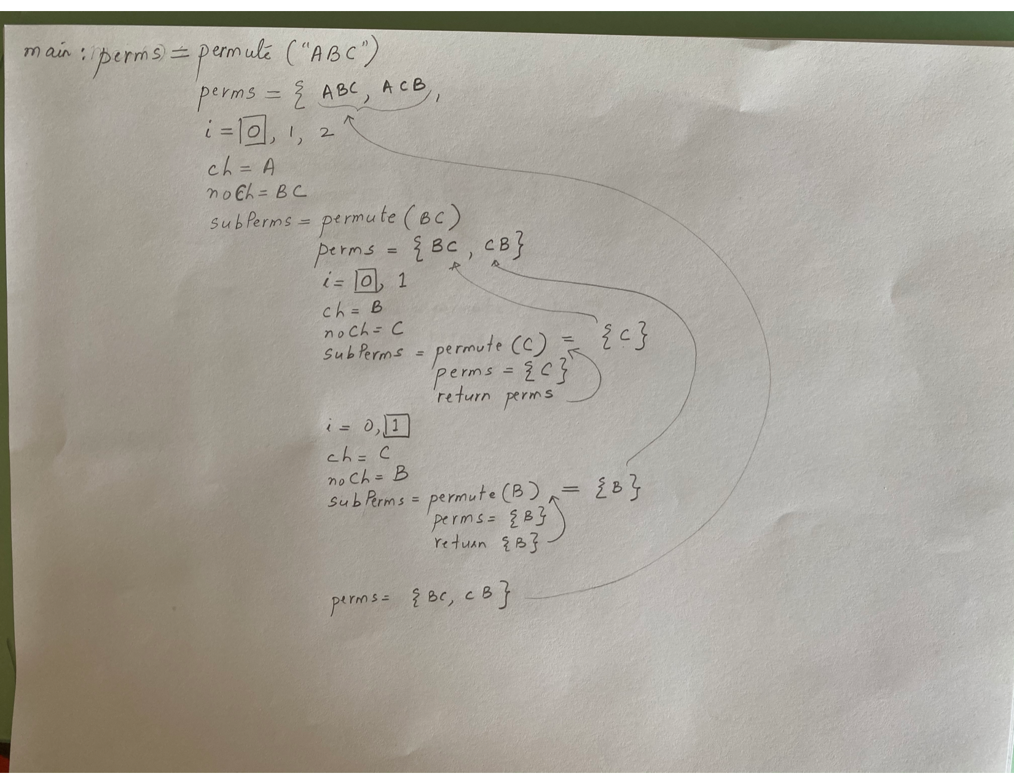

Slide 15
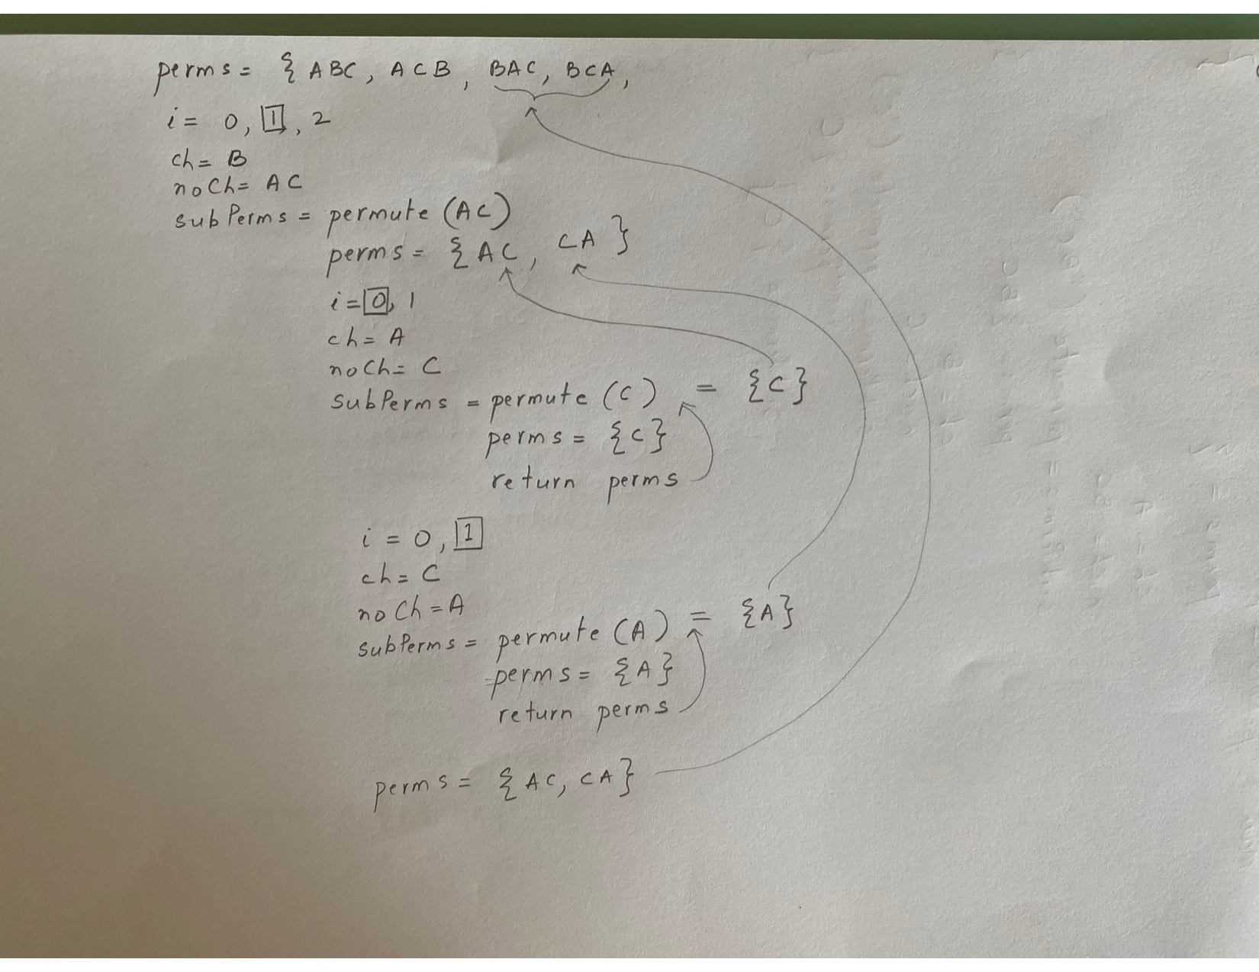

Slide 16
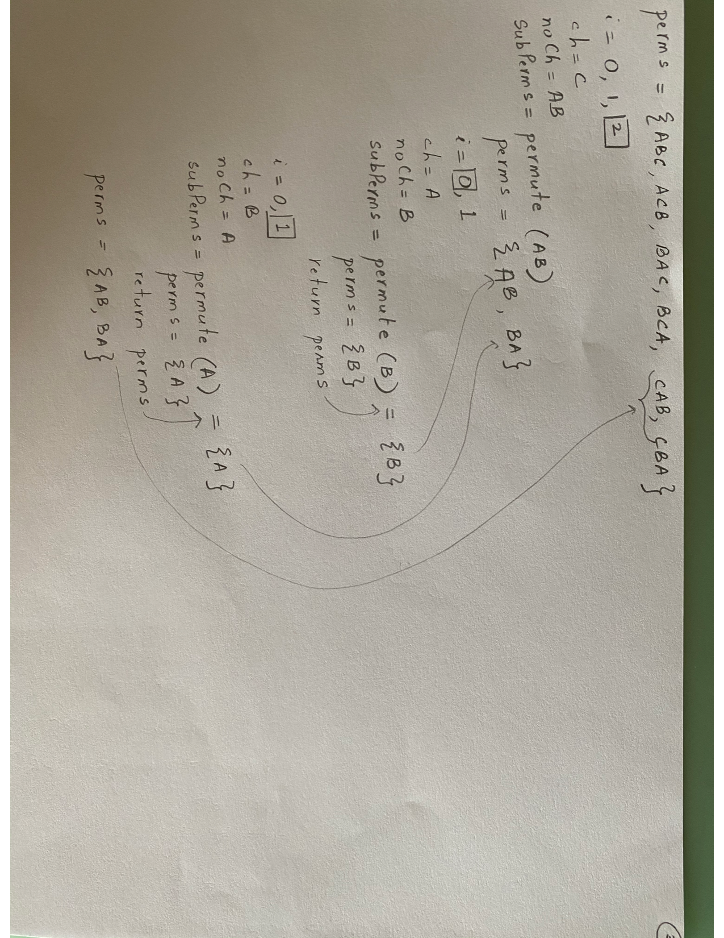

Slide 17
Subsets
Subsets(“abc”) “abc”, “ab”, “ac”, “a”, “bc”, “b”, “c”
Usage: Problems that ask for a selection of items from a set that meets some criteria
Examples:
Given a collection of coins, make change equal to x
Scrabble: What is the best word you can make from a given set of letters?
Shopping: How many, or which items, can we get for a given dollar amount
Number of subsets
2^{n} subsets exist for n items
2¹⁰ = 1024
2²⁰ > 1 million

Slide 18
Subset Algorithm
Let’s redefine subset(str) as subset(head, rest)
Now we can get all the subsets in rest that are prefixed by head
subset(“”, “ABC”) { “ABC”, “AB”, “AC”, “A”, “BC”, “B”, “C”, “”}
The whole problem
subset(”A”, “BC”) “A” before {“BC”, “B”, “C”, “”} {“ABC”, “AB”, “AC”, “A”}
The first half of the solution
subset(””, “BC”) “” before {“BC”, “B”, “C”, “”} {“BC”, “B”, “C”, “”}
The second half of the solution
subset(“”, “ABC”) subset(“A”, “BC”) + subset(“”, “BC”)

Slide 19
Subset Algorithm
subsets(s) =
Base Case(s): if rest is empty, then return {head}
Recursive Case(s): Move first character of read into head. Add all subsets of rest prefixed by head (via recursion)
And then remove the first character of rest. Add subsets of rest prefixed by head (using recursion)

Slide 20
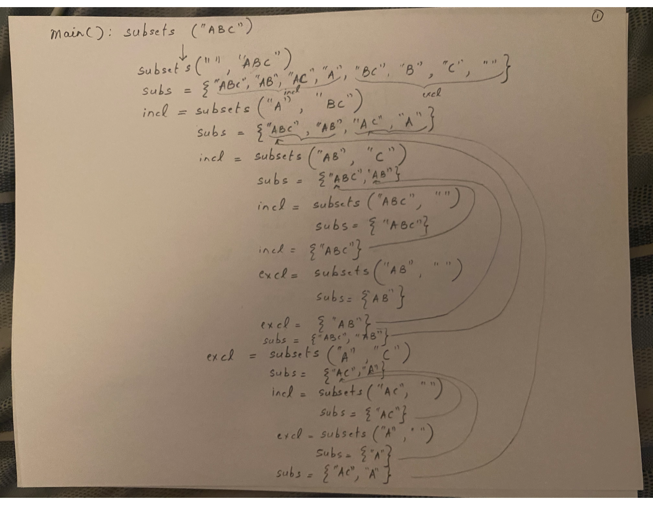

Slide 21
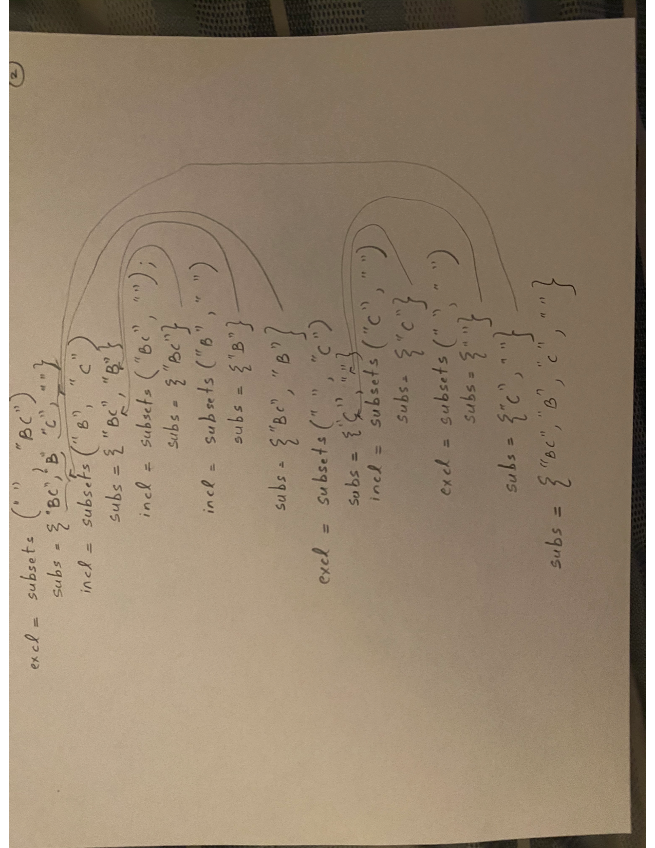

Slide 22
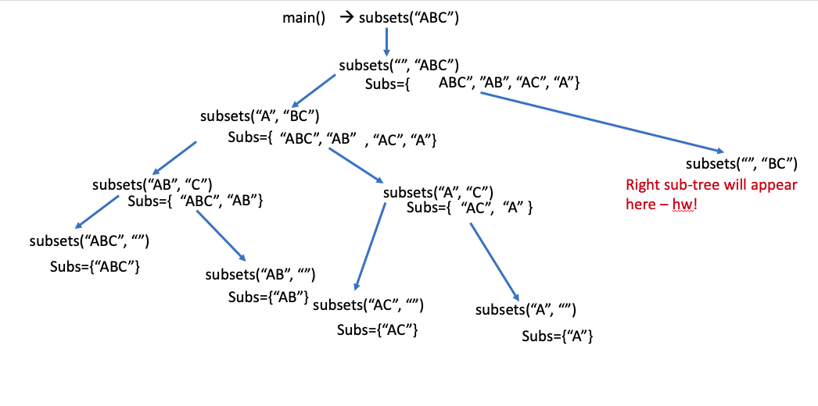

Slide 23
Combinations
Combinations(“abc”, 2) returns ab, ac, bc
Uses
Problems that ask you to pick all possible, or the best, k outcomes of n items
Example: List all possible pick-2 or pick-3 meals
Implementation: In Homework 1
We can get there by understanding and modifying the subsets algorithm

Slide 24
Recursive Backtracking
When we are returning form a recursive call, all of the parameters and local variables returned to their prior values, and the program picks up where it left off

Slide 25
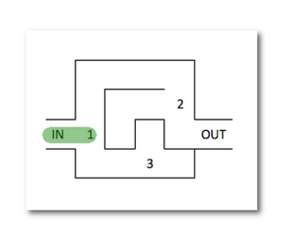
Maze Solving

Slide 26
Maze Solving
Make a choice
If (recursion can solve the remaining problem), then we are done
Otherwise, undo the choice
Repeat with the next decision
Out of choices and not complete? Then there is no solution

Slide 27
Split Arrays using Recursive Backtracking
Split Array: Given an array of integer values, can the values be split into two groups that have an equal sum?
For now we will just have a True/False answer
Homework 1 will have you return the actual lists
Example: Given the list {5, 1, 4} how could this be split into two lists of equal sum?

Slide 28
Split Arrays using Recursive Backtracking
Split Array: Given an array of integer values, can the values be split into two groups that have an equal sum?
For now we will just have a True/False answer
Homework 1 will have you return the actual lists
Example: Given the list {5, 1, 4} how could this be split into two lists of equal sum?
{5} and {1, 4}, therefore return true
What about {3, 2, 6} ?

Slide 29
Split Arrays using Recursive Backtracking
Split Array: Given an array of integer values, can the values be split into two groups that have an equal sum?
For now we will just have a True/False answer
Homework 1 will have you return the actual lists
Example: Given the list {5, 1, 4} how could this be split into two lists of equal sum?
{5} and {1, 4}, therefore return true
What about {3, 2, 6} ?
No such lists exists, therefore return false

Slide 30
Split Array Algorithm
splitArray(nums, list1, list2, start)
Can we put nums from start into list1 and list2 such that list1 == list2?
Base Case(s):
If we are out of nums, then we crossed the last valid index
If list1 == list2, return true
If list1 != list2, return false
Recursive Case:
If we can solve the rest with nums[start] in list1, then true
If we can solve the rest with nums[start] in list2, then true
If not, then no solution, so false

Slide 31
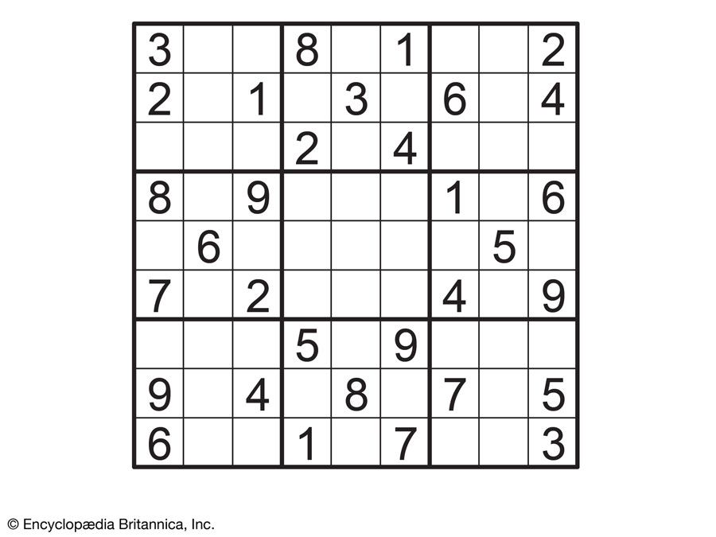
Solving Sudoku

Slide 32
Recursive Backtracking: Sudoku
miniSudokuSolver(board)
Either prints the solved puzzle board or “No Solution”
Recursive Problem transformation
miniSudokuSolver(board, r, c)
Returns true if solved or false if there is no solution

Slide 33
Sudoku: Recursive Solution
Base Case:
If board is solved return true
If board has no solution, return false

Slide 34
Sudoku: Recursive Solution
Recursive Cases:
If r, c has a value, return miniSudokuSolver(board, next_row, col)
Try 1 at (row, col)
If (miniSudokuSolver(board, next_row, col)) → true
Remove 1 from (row, col)
Place 2 at (row, col)
If(miniSudokuSolver(board, next_row, col)) → true
Remove 2 from (row, col)
Place 3 at (row, col)
If(miniSudokuSolver(board, next_row, col)) → true
Remove 3 from (row, col)
Return false

Slide 35
0 0 0
0 0 3
1 0 0
1 0 0
0 0 3
1 0 0
2 0 0
0 0 3
1 0 0
2 1 0
0 0 3
1 0 0
2 1 1
0 0 3
1 0 0
2 1 2
0 0 3
1 0 0
2 1 3
0 0 3
1 0 0
2 2 0
0 0 3
1 0 0
2 3 0
0 0 3
1 0 0
2 3 1
0 0 3
1 0 0
2 3 1
1 0 3
1 0 0
2 3 1
2 0 3
1 0 0
2 3 1
3 0 3
1 0 0
2 3 2
0 0 3
1 0 0
2 3 3
0 0 3
1 0 0
3 0 0
0 0 3
1 0 0
3 1 0
0 0 3
1 0 0
3 1 1
0 0 3
1 0 0
3 1 2
0 0 3
1 0 0
3 1 2
1 0 3
1 0 0
3 1 2
2 0 3
1 0 0
3 1 2
2 1 3
1 0 0
3 1 2
2 2 3
1 0 0
3 1 2
2 3 3
1 0 0
3 1 2
3 0 3
1 0 0
3 1 3
0 0 3
1 0 0
3 2 0
0 0 3
1 0 0
3 2 1
0 0 3
1 0 0
3 2 1
1 0 3
1 0 0
3 2 1
2 0 3
1 0 0
3 2 1
2 1 3
1 0 0
3 2 1
2 1 3
1 0 0
3 2 1
2 1 3
1 0 0
3 2 1
2 1 3
1 1 0
3 2 1
2 1 3
1 2 0
3 2 1
2 1 3
1 3 0
3 2 1
2 1 3
1 3 1
3 2 1
2 1 3
1 3 2
3 2 1
2 1 3
1 3 2

